Slide 1






The Pharmaceutical Strategy for Europe & the revision of the general pharmaceutical legislation
Magda Chlebus
CEFI, 26 September 2022

Slide 2
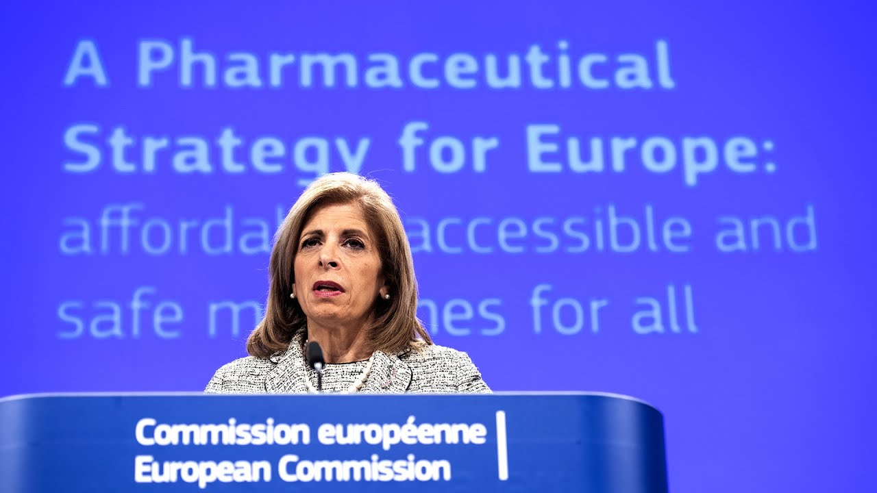
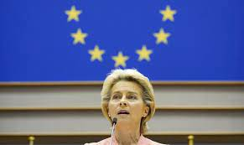
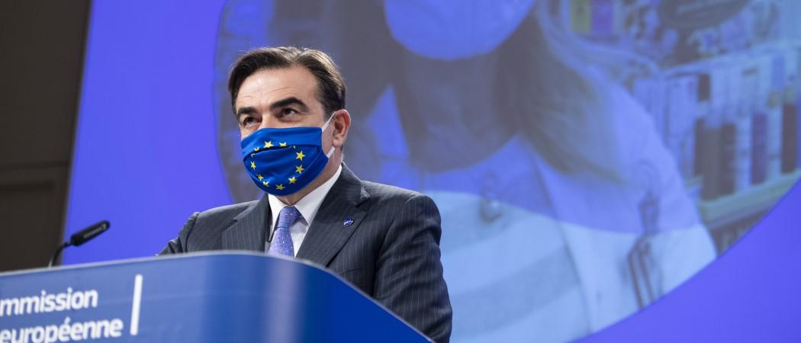

The stated intent: enhance health and innovation
Supply of affordable medicines
Ensure that pharma industry remains an innovator and world leader
Mission letter to Commissioner Kyriakides
Stronger European Health Union in which 27 countries work together prepare and respond collectively to health threats
President Ursula von der Leyen, EU Health Union
Competitive and innovative pharma industry,
whilst addressing the needs of the patients and health systems
Vice-President Schinas, Pharmaceutical Strategy for Europe
Sustainable production of affordable medicines,
Support innovation, making Europe a leader in biomedicines
EU leaders, Versailles Declaration
COVID-19 pandemic
Joint procurement, advance purchase agreements, IP waiver
War in Ukraine
Europe’s strategic autonomy, Health IPCEI
December 2019
September 2020
November 2020
March 2022

Slide 3
Pharmaceutical Strategy for Europe
Review of the pharmaceutical legislation
Adopted in November 2020
More than 50 different legislative and non-legislative actions
To ensure access to quality and safe medicines, while boosting industry global competitiveness
Deliver to patients
Competitive and innovative environment
Enhancing resilience
Strong EU voice globally
Legislative proposal planned by end of the year but delayed until Spring 2023, Review of:
The 2001 Pharmaceutical Directive (2001/83)
The 2004 EMA Regulation (746/2004)
The 2000 Orphan Drugs Regulation (141/2000)
The 2006 Paediatric Regulation (1901/2006)
Notes:
Nathalie

Slide 4
Impact Assessment Report: 77 measures reviewed against 5 objectives:
Encouraging further innovation | Supporting a strategic industry | Promoting improvements in access and affordability |
Reducing the environmental footprint | Reducing the regulatory burden
Option A: Address identified problems/objectives through incentives
Option B: Address identified problems/objectives through additional obligations
Option C: Propose a ‘quid pro quo approach’ with a modulated system of incentives
A.4.2. Milestone incentive: + 6 months data protection if product marketed in all MS within 5 years
A.4.3. (non-regulatory option) Voluntary reporting of market launches within 2 years of centralized authorization
A.4.4. Allow early generic entry if centrally approved product is not placed in majority of MS (small markets) within 5 years
C.4.3. 2 years of data protection conditional on launch on all EU markets within 2 years
C.4.4. (same as B.4.4): Requirement for MAH applying for MRP/DCP to include small markets
B.4.2. Require MAHs to notify regulators of their market launch intentions
B.4.3. Obligation to place a centrally approved product on the market in the majority of MS within 5 years
B.4.4. Requirement to MAH applying for MRP/DCP to include small markets
The Commission considers that option C strikes the best balance between the five stated objectives

Slide 5
Overview of Commission preferred policy option C for incentives
Reduction of Regulatory Data Protection (RDP) baseline from 8 to 6 years
8 years RDP can be retained if product placed on all EU27 markets within 2 years
+ 1 year RDP for products that fulfil definition of Unmet Medical Need (very narrow according to drafts)
+ 6 months RDP for products where comparative trials included in regulatory dossier
Total RDP can not exceed 11 years
Transferable Exclusivity Extension (TEE) proposed for AMR

Slide 6



Main opportunities and risks
    A framework stifling innovation in Europe
    A globally competitive policy ecosystem fostering innovation in Europe
Disproportionate obligations for companies
Reduced incentives for R&D
Conditionality of incentives
Future-proof regulatory system
Novel incentive for AMR
Improved European health data environment

Slide 7
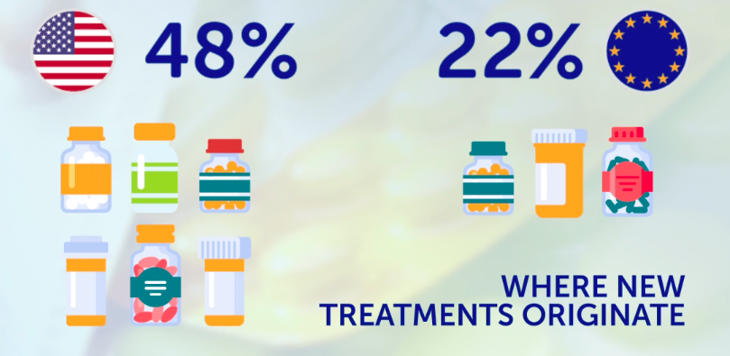
Simultaneously: Europe’s research and development base is gradually eroding
Only through a future-proof regulatory framework, and a robust and predictable intellectual property and incentives ecosystem, can Europe become a true world-leader in medical innovation.

Slide 8
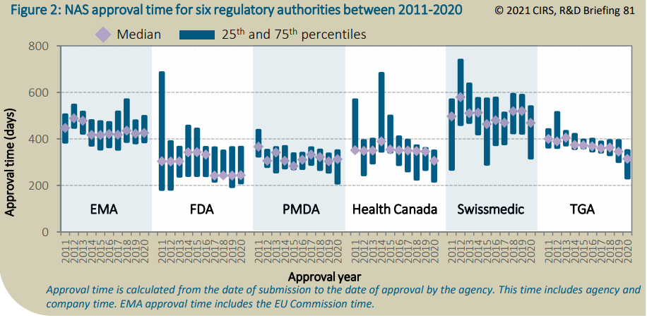
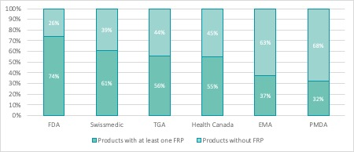
Approval time and expedited pathways across regulatory agencies
2021: 426 days median EMA approval time
European patients waiting almost the double than in the US (244 days) to access new medicines
2021: EMA authorized 54 active new substances via expedited reviews (i.e., accelerated assessment)
vs 50 in the United States, 45 in Switzerland, 40 in Australia

Slide 9



To stimulate innovation in underserved diseases (“white spots”), scientific, regulatory, policy aspects must be addressed jointly
Unlock,
de-risk,
and accelerate science
Optmise and modernise regulatory practice and processes
Create Policy pulls to sustain patient centric innovation

Slide 10


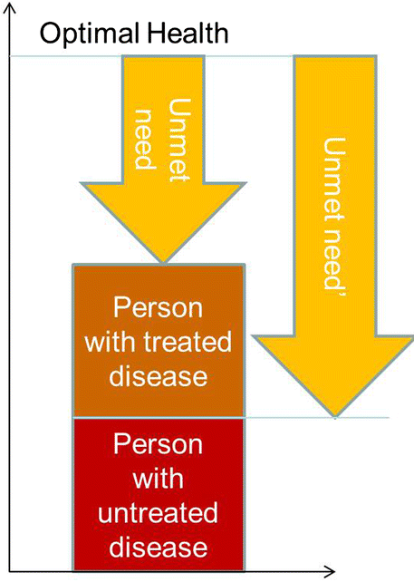
Unmet Medical Need: It all starts with patients and science
Lack of adequate authorised prevention, treatment or cure
Need is evolving and is not a binary concept
Availability of
Scientific clues
Technology
Data
Infrastructure
Collaboration

Slide 11
…and it depends on context and perspective
Patient perspective: emphasis on burden of disease of the individual, from improvement of quality of life by a new formulation to life-extending treatments​
Societal perspective: emphasis on (incremental) improvements in diseases with a high societal burden or treatments that help prepare for future pandemics ​
Healthcare system perspective: emphasis on efficient resource allocation and cost-effectiveness of treatments that support and improve the overall functioning of the system​
Patient perspective
Burden of disease at the level of the individual
Societal perspective
Prevalence in combination with BoD (population level)
Healthcare system perspective
Efficiency, cost-effectiveness of treatments etc.

Slide 12
It matters where the innovation takes place
Medical innovation is happening and it's happening fast
The issue for Europe is where that innovation happens.
If the European policy environment means that innovations happens in other parts of the world it will have implications for:
Patient access to new therapies
Europe's research community more broadly including SMEs and academia
Europe's economic growth and inward investment
Europe's resilience to future health threats

