Slide 1






EU pharmaceutical legislation review
Magda Chlebus, Executive Director Science & Regulatory, EFPIA

Slide 2
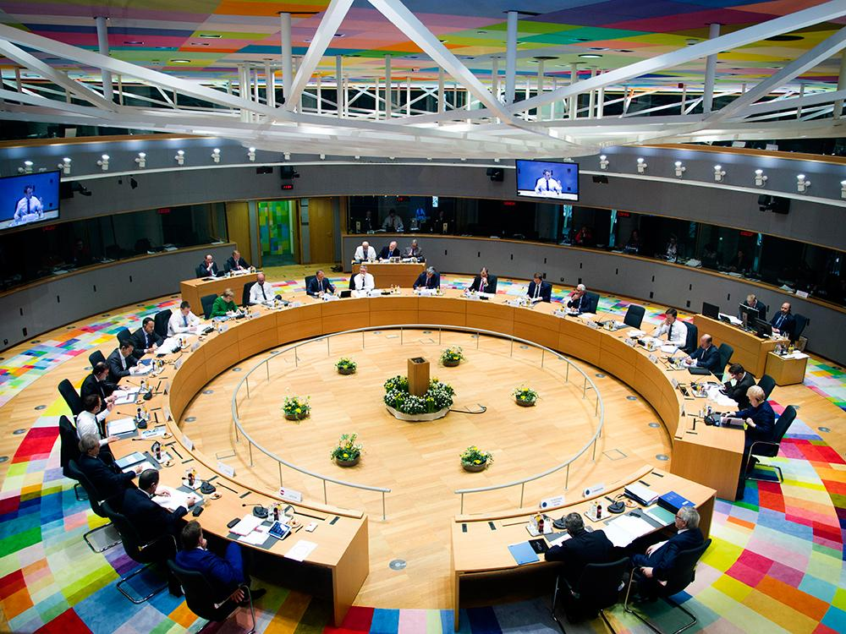


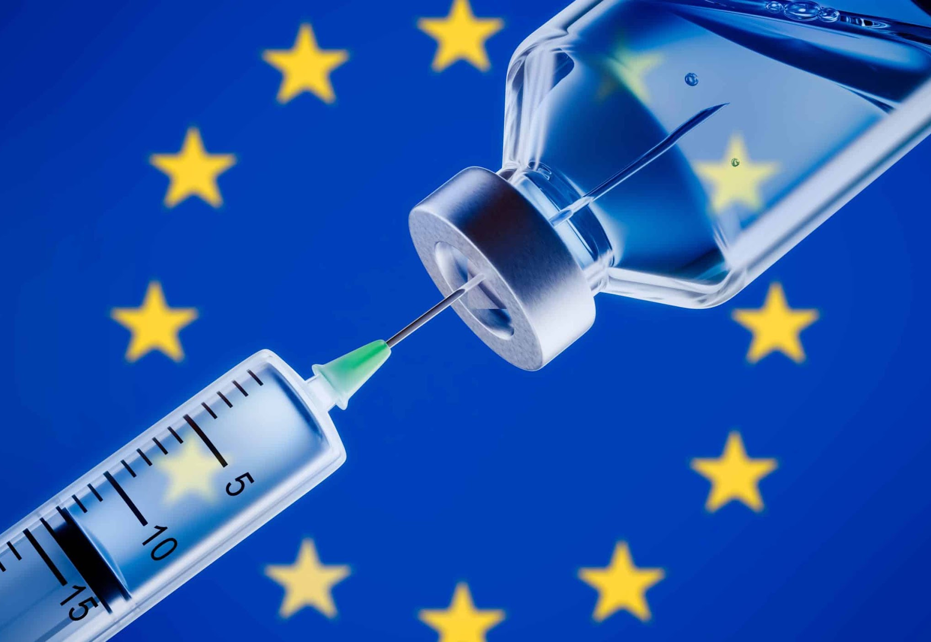
Major revision of EU pharmaceutical laws upcoming and healthcare
high up on the Brussels political agenda – how did we get here?
2016
Council conclusions
on strengthening the balance in the pharmaceutical systems in the European Union and its Member States
2020
COVID-19, war, inflation and energy crisis
November 2020
Pharmaceutical
Strategy for Europe
2023
Revision of the EU general pharmaceutical legislation and the orphan and paediatric regulations

Slide 3


Complementary EU and national responsibilities
  Ensuring Europe's competitiveness & addressing the needs of patients
General pharmaceutical legislation:
regulates authorisation, manufacturing, distribution and monitoring of medicines + provides regulatory protection to reward innovative medicines
Orphan Medicinal Products + Paediatric Regulation:
complement the general pharmaceutical legislation – support
the development of medicines in previously neglected areas)
National reimbursement legislation:
regulates access and reimbursement of medicinal products
Health care system readiness:
ensure future proof health systems
© European Union, 2020 © European Union, 2014 / Source: EC - Audiovisual Service

Slide 4

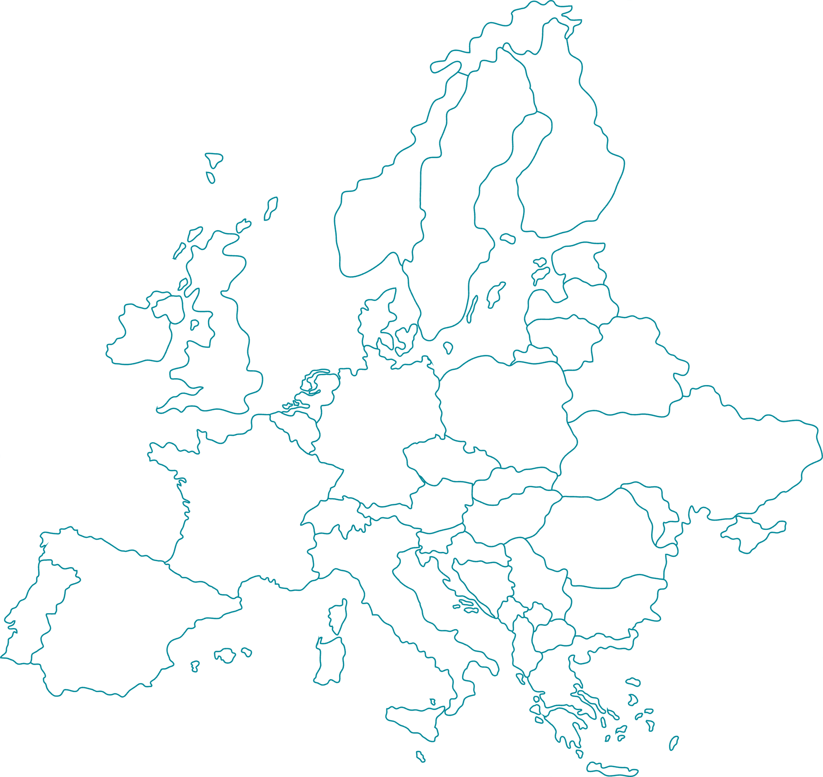
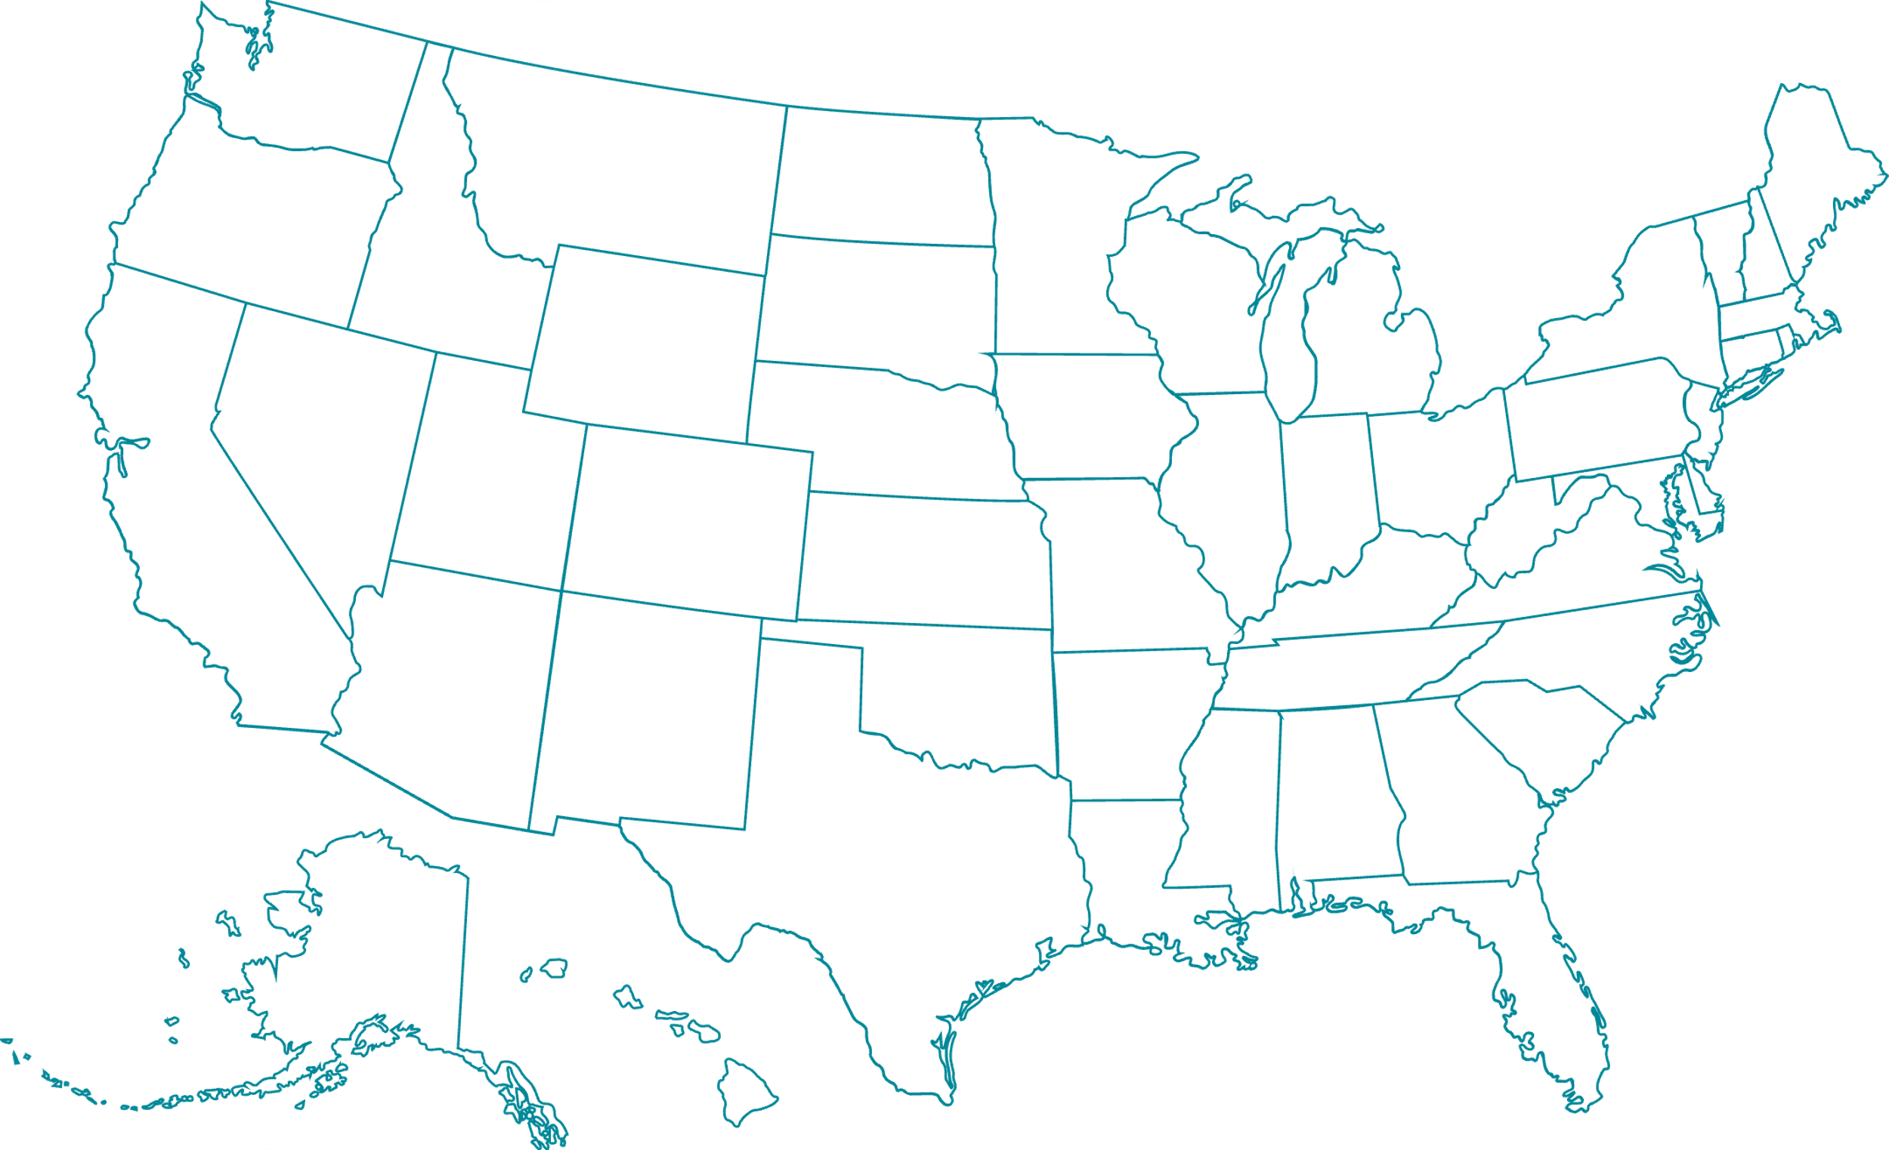
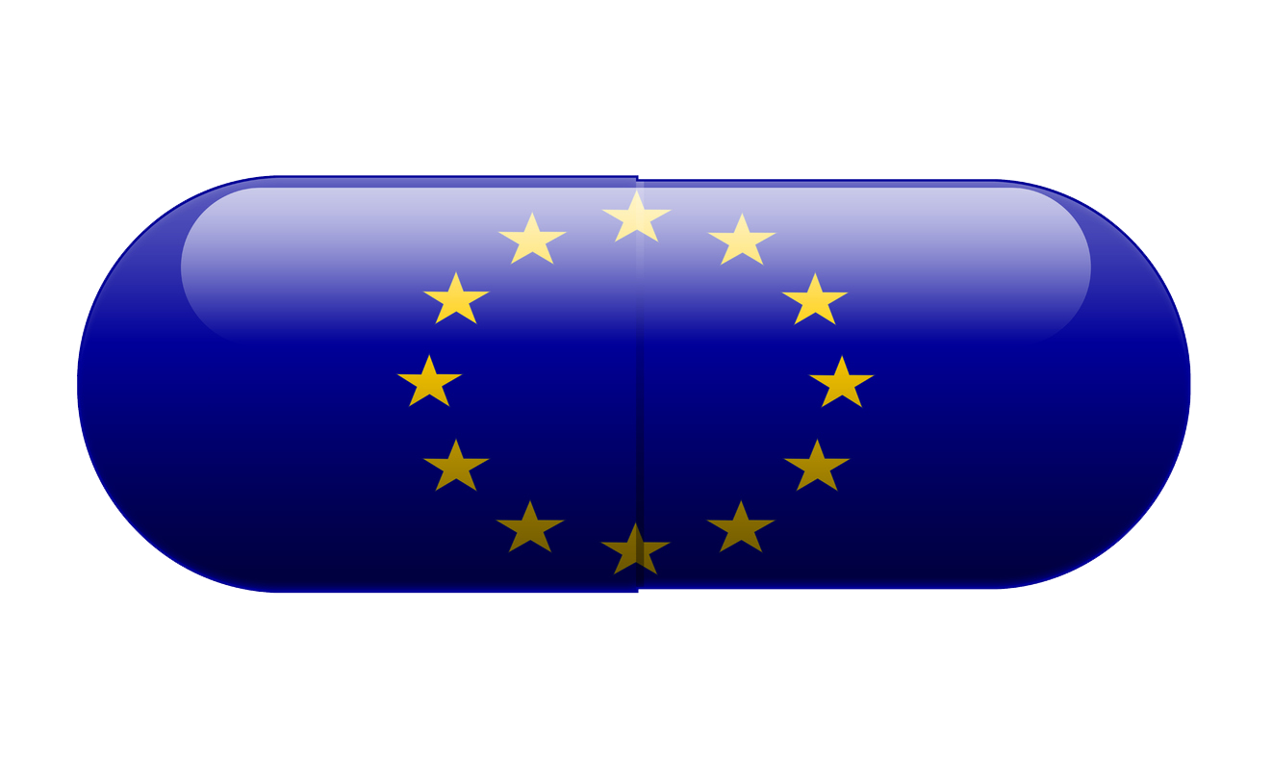

Access and availability drive the debate, but Mind the gap
  Europe’s research and development base is gradually eroding
Where new treatments originate
MIND
In 2002, the US spent €2billion more than
Europe on medicines R&D; today the
difference in €25billion
THE GAP
22%
48%
Only through a future-proof regulatory framework, and a robust and predictable intellectual
property and incentives ecosystem, can Europe become a true world-leader in medical innovation

Slide 5





The European regulatory system is slower than others
Europe is the slowest in the region to approve new medicines in comparison to the US, Japan, Canada and Australia
244 days
306 days
313 days
315 days
426 days
New therapies approved via expedited reviews in 2021
When compared to other regions of the world, in 2021 the EMA
had an extremely low percentage of new active substances
approved via expedited reviews
71%
45%
14%
9%
SOURCE: https://cirsci.org/wp-content/uploads/dlm_uploads/2022/06/CIRS-RD-Briefing-85-6-agencies-v2.3.pdf

Slide 6

Futureproofing the regulatory framework
  Rapid scientific and technological developments bring new challenges for the system,
  Europe is facing increased competition from other regions
In the past 20 years, the EU pharmaceutical legislation has turned into a complex framework. The efficiency and competitiveness of the framework need to be enhanced. Pharmaceutical legislation needs adequate agility and resources to be futureproof for emerging scientific discoveries. Adaptability is essential
The regulatory system needs to evolve to seize the new opportunities science is offering. This will allow the adoption of technological advances and the utilisation of real world evidence and data analytics in regulatory decision making. In turn, this will help Europe to remain competitive in the face of fierce global competition
Median
approval
time
Median
approval
time
Graph source: CIRS, 2021

Slide 7
EU Commission legislative proposals published on 26th April 2023
  3-5 years of negotiations expected before adoption
“General pharmaceutical legislation - GPL”
(regulates authorisation, manufacturing, distribution and monitoring of
medicines + provides regulatory protection to reward innovative medicines)
“Orphan regulation” and “Paediatric regulation”
(complement the general pharmaceutical legislation – support
the development of medicines in previously neglected areas)
Directive 2001/83/EC
On the community code
relating to medicinal products
for human use
Regulation (EC) No 726/2004
Laying down union procedures for the authorisation and supervision of medicinal products for human use and establishing a European medicines agency
Regulation (EC) No 141/2000
On orphan medicinal products
Regulation (EC) No 1901/2006
On medicinal products
for paediatric use
FROM THREE TO ONE
Directive
On the union code relating to medicinal products for human use
Regulation
Laying down union procedures for the authorisation and supervision of medicinal products for human use and
establishing a European medicines agency, amending regulation (EC) no 1394/2007 and regulation (EU) no 536/2014
and repealing regulation (EC) NO 726/2004, regulation (EC) no 141/2000 and regulation (EC) no 1901/2006

Slide 8




Reform of the EU Pharmaceutical Legislation
having 6 Key political objectives
No Single Market
Access
Shortages and
security of supply
Availability
Budgets
Affordability
Competitive
Regulatory framework
Checking
Environmental sustainability
Combatting
AMR
Single market of medicines in the EU
A once in a generation opportunity to upgrade the EU regulatory system and ensure that
Europe bridges the gap with other regions and comes back as a world leader in
biopharmaceutical innovation to the benefit of European patients
8

Slide 9
Directive vs regulation: what does each cover?
DIRECTIVE
REGULATION
Environmental measures
Specific requirements for antimicrobials
Guidance for Environmental Risk Assessments (ERA) for older products
ERA scope extended to cover the entire life cycle of medicines
Environmental measures
ERA scope extended to cover the entire life cycle of medicines
Marketing authorisation refusal in case of ERA requirements not
being addressed
Specific requirements for products containing GMO
ERA scope extended to cover the entire life cycle of medicines
Paediatric medicines
ONLY: Paediatric use marketing authorization procedure
Paediatric medicines
Unmet Medical Need
Assessment and decision timeline
Regulatory Data Protection (duration, conditionalities, obligations)
Scientific advice (PRIME)
Electronic product information
Security of supply and shortages
Market Exclusivity for orphan drugs
European Medicines Agency
Transparency
Orphan Medicinal Drugs/high unmet medical need
Bolar exemption
Antimicrobial Resistance
Regulatory sandboxes

Slide 10




EU Commission legislative proposal
  Topic areas under discussion
Incentives for innovation
Reduction of regulatory data protection
Future proofing the EU regulatory system
Adapted regulatory framework
for selected technologies
AMR
Holistic approach with measures on
incentives, access, regulatory, environment
Pharmaceutical Regulation and Directive
Addressing environmental challenges
Include assessment ERA of manufacturing into MA dossier
Competition: generic, biosimilar entry
Broaden Bolar exemption
Quality & manufacturing
Extended scope of mandatory inspections and stronger EMA role
Security of supply
Increased obligation for MAH to ensure appropriate and continued supplies
OMP & Paediatric
OMP: reduction of incentives
PAED: increased obligations and penalties
UMN
Introduction of a narrow
definition of unmet medical need
CONFIDENTIAL – NOT FOR EXTERNAL DISSEMINATION

Slide 11
Incentives for innovation
Reduction from 8 to 6 Yr. Baseline RDP
+ 2 Yr. for release + supply in all MS where MA is valid within 2 yr. (3 for SME)
+ 0.5 Yr. for meeting UMN criteria
+ 0.5 Yr. for comparative clinical trials
+ 1 Yr. for New Therapeutic Indication
+ 2 Yr. Baseline Market Protection
EU Commission legislative proposal
  Topic areas under discussion
Future proofing the EU regulatory system
Adapted regulatory framework
for selected technologies
Regulatory sandboxes for complex /
cutting edge medicines
AMR
Holistic approach with measures on incentives, access, regulatory, environment
“Transferable Exclusivity Data Voucher” for priority antimicrobials under strict conditions as key incentive
EC recommends multi country incentive to foster access
Pharmaceutical Regulation and Directive
Addressing environmental challenges
Refusal of MA based on environment concerns
Include assessment of environmental risk of manufacturing into MA dossier for antimicrobials
Restrictions for hazardous and high risk APIs
Competition: generic, biosimilar entry
Broaden Bolar exemption
Quality & manufacturing
Further expand master files with PTMF
Overcome technology lock in Dir Annex II
Further eliminate the need for testing on importation
Security of supply
Obligation for MAH to ensure appropriate and continued supplies to wholesalers and pharmacists
6 month notification period for all shortages
Prevention and mitigation plans for all medicines
Increased supply chain transparency
OMP & Paediatric
Reduction of OME from 10 to 9years + linked
to molecule
ODD validity cap
PIP reward remains (omission of +2y OME), but deferral
of max 5 years + increased obligations and penalties
UMN
Criteria are based on life-threatening or seriously debilitating disease
If there is a treatment option or not meaningful reduction for mortality or morbidity

Slide 12


EFPIA’s perspective on the Commission’s proposed measures
Needing further consideration to close the gap
Heading in the right direction / almost there
Regulatory Data Protection
Regulatory sandboxes
Market Exclusivity provisions for orphan drugs
Electronic product information
Unmet Medical Need definition and criteria
Assessment and decision timeline
Bolar exemption
Scientific advice (PRIME)
Paediatric medicines PIPs
Security of supply and shortages
Environmental risk assessment
European Medicines Agency re-structure
Antimicrobial Resistance Transferable Exclusivity Vouchers

Slide 13


EFPIA response to the Pharmaceutical Legislation
Strengthen, rather than cut, the region’s RDP baseline as well as creating separate incentives to drive innovation and meet health care challenges such as AMR
Manufacturing
Include a patient-centred, broad definition of unmet medical need that would incentivise avenues of research to meet the needs of patients with rare diseases and chronic conditions, and
appropriately value incremental innovation
Development
UMN
Research
Access to
medicine
Optimise the regulatory framework and ensuring maximum use of expedited pathways in support of patient needs
Marketing authorisation
Value assessment
and pricing and
reimbursement
IP
PATIENTS
Ensure that supply chain and environmental requirements are proportionate and fit for purpose, to best support our shared objectives of increasing supply of medicines and reducing our sector’s environmental impact
Jointly address barriers and delays to access based on a shared understanding of the evidence generated by the recently published Industry European Access
Hurdles Portal
13

Slide 14




Take home messages
Europe needs globally competitive regulatory system that can keep
pace with science and technology evolution and supports future innovations
Many of the Commission proposals align with this aspiration and intent to simplify, accelerate, optimise regulatory processes
To bring Europe on the R&D map and balance access and competitiveness, adjustments are needed to incentives proposals.
14

