Slide 1
EHDS
Secondary use of data for research
Angel Martin
Senior Director, Digital Health and Tax Advocacy EMEA
24 October 2023

Slide 2

Creating an EU health data ecosystem
The EHDS is […] crucial to develop life-saving treatments, vaccines or medical devices and ensuring better access to healthcare and more resilient health systems.
– Health Commissioner Kyriakides

Slide 3



What is the European Health Data Space?
A health data ecosystem built through legislation, infrastructure and governance
Major system shift to unleash potential of data in:
Delivery of Care
Empowering patients on their health data and and HCPs in delivery of care across EU borders
Electronic Health Records
Upgrade generation of high-quality data through common standards in Electronic Health Records Systems
Research & Innovation
Use of health data for R&D, innovation and personalised medicines

Slide 4



EHDS: a multi-layered structure
A health data ecosystem built through legislation, infrastructure and governance
Framework Legislation
2022-2024 (TBC)
Principles / Scope
Purpose, Data types, Conditions
Technical Legislation
2025-… TBC)
Standard Definition
Implementing rules
National Data Spaces and Infrastructure
2022-…
National/Regional Spaces (aligned with the framework): new (BE, DE, ES…), existing (FI, DK, EE, FR)
Interoperability, Connectivity abd Infrastructure – how do we connect the Spaces

Slide 5

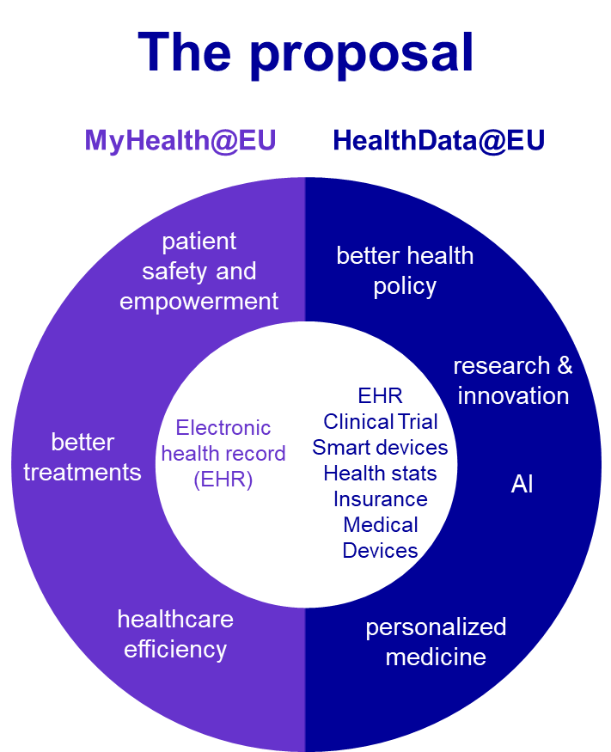





EHDS – a (r)evolution in health data
EHR systems governance
Access to data
Provides common European purposes of access for public and private actors. Includes innovation of new products/ services; training of algorithms in medical devices and digital health apps; and providing personalized healthcare
Establishes mandatory regulatory scheme for Electronic Health Record Systems, with requirements for interoperability, security, access to data and governance (including self-certification)
Harmonised technical standards
Provision of data
Provide access to health data held by entities (incl healthcare companies) for secondary use, including electronic health data entailing protected IP and trade secrets (measures to preserve confidentiality shall be taken).
Commission selection of standards and common specifications to avoid interoperability, security, quality risks.
Data quality requirements
Empowering patients
Ensures free access and control of their electronic health records, with the ability to edit or transmit the data
Datasets in EHDS may have a data quality and utility label, which will consider requirements such as FAIR, documentation, technical quality, quality management process, coverage and linkages.

Slide 6
Secondary use of data
Types of Data
Context of Data Generation
Purposes for Public Actors
Prohibited Uses
EHRs
Determinants of health
Pathogen genomic
Administrative
Genetic, genomic, proteomic
Person-generated
HCP identification
Broad registries
Specific registries
Clinical trials
Medical devices
Research cohorts
Biobanks
Insurance status, education, lifestyle, wellness, behaviour
Improved sets from EHDS use
public interest (e.g. protection against serious cross-border threats to health)
support public sector bodies, incl regulatory authorities, to carry out their tasks
produce official statistics
education or teaching activities
Purposes for Private Actors
decisions detrimental to a person
decisions to exclude people from benefit of insurance contract;
advertising or marketing activities for HCPs or natural persons;
providing access to 3rd parties not mentioned in data permit;
developing products/ services harming individuals and societies
Collected for purposes of:
healthcare
public health
research
innovation
policy making
official statistics
patient safety
regulatory
scientific research
development and innovation activities for products or services
training, testing and evaluating of algorithms, including in medical devices, AI systems and digital health applications,
providing personalised healthcare
Notes:
Types of data:
EHRs;
data impacting on health, including social, environmental behavioural determinants of health;
relevant pathogen genomic data, impacting on human health;
health-related administrative data, including claims and reimbursement data;
human genetic, genomic and proteomic data;
person generated electronic health data, including medical devices, wellness applications or other digital health applications;
identification data related to health professionals involved in the treatment of a natural person;
population wide health data registries (public health registries);
electronic health data from medical registries for specific diseases;
electronic health data from clinical trials;
electronic health data from medical devices and from registries for medicinal products and medical devices;
research cohorts, questionnaires and surveys related to health;
electronic health data from biobanks and dedicated databases;
electronic data related to insurance status, professional status, education, lifestyle, wellness & behaviour data relevant to health;
electronic health data containing various improvements such as correction, annotation, enrichment received by the data holder following a processing based on a data permit.
Purposes for secondary use
activities for reasons of public interest in the area of public and occupational health, such as protection against serious cross-border threats to health, public health surveillance or ensuring high levels of quality and safety of healthcare and of medicinal products or medical devices;
(b) to support public sector bodies or Union institutions, agencies and bodies including regulatory authorities, in the health or care sector to carry out their tasks defined in their mandates;
(c) to produce national, multi-national and Union level official statistics related to health or care sectors;
(d) education or teaching activities in health or care sectors;
scientific research related to health or care sectors;
development and innovation activities for products or services contributing to public health or social security, or ensuring high levels of quality and safety of health care, of medicinal products or of medical devices;
training, testing and evaluating of algorithms, including in medical devices, AI systems and digital health applications, contributing to the public health or social security, or ensuring high levels of quality and safety of health care, of medicinal products or of medical devices;
providing personalised healthcare consisting in assessing, maintaining or restoring the state of health of natural persons, based on the health data of other natural persons.

Slide 7
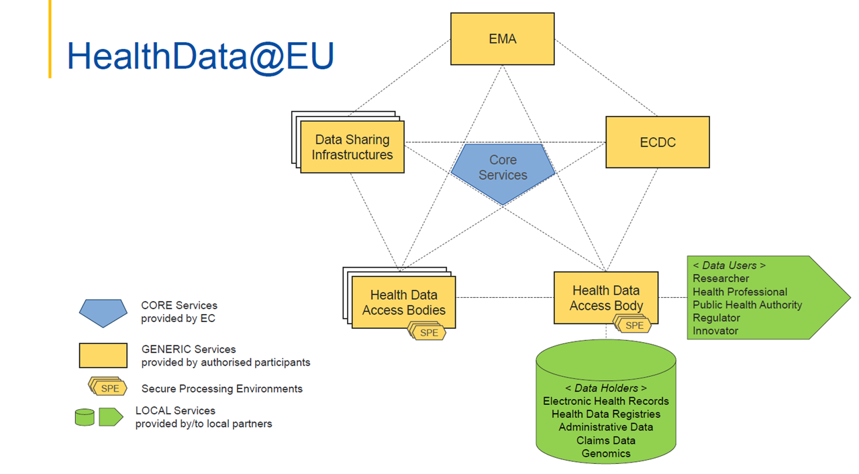
EHDS Visualization

Slide 8
Links to Other Policies & Legislations
EHDS has strong links to both past and current legislation and policy proposals
GDPR, Data Governance Act & Data Act
Artificial Intelligence Act
Medical Device Regulations
EHDS builds upon and develops GDPR rights, and complements horizontal data legislations by providing tailor-made rules for health sector
EHDS supports and complements training of AI, interoperability of AI and EHR systems and data quality
If manufacturers notify interoperability of devices with EHR systems, EHDS requirements apply
EU Cybersecurity Framework
(NIS 2.0 Directive)
European Health Union
TEHDAS Joint Action
EHDS complements this horizontal legislation and provides more tailor-made rules for the health secctor
EHDS will boost the work of the EU Cancer Plan, HERA, Pharmaceutical Strategy for Europe
Supports in building EHDS by developing principles for crossborder secondary use of health data

Slide 9
Opportunities & Challenges
Opportunities
Challenges
Harmonized data access and sharing
Promote a data culture in health systems
Helping existing and new collaborations
Fragmented interpretation across countries
Unclear consistency with other legislation (GDPR, IP)
Insufficient funding for implementation

Slide 10
Timeline for Adoption
Plenary vote (22/11/2023)
ENVI-LIBE amendments (23/03/2023)
ENVI-LIBE report vote (09/11/2023)
European Parliament
ITRE amendments (09/03/2023)
IMCO opinion (25/05/2023)
IMCO amendments (07/03/2023)
ITRE opinion (23/05/2023)
ITRE draft report (14/02/2023)
European Commission
LIBE-ENVI
joint meeting
LIBE-ENVI draft report (10/02/2023)
IMCO draft report (08/02/2023)
NOW
Proposal
2023
2024
General approach
and kick-off trialogue (30/11/2023)
Second Presidency compromise text on Chapters I-III, Arts 33-35, Chapters V-VIII (08/05/2023)
Second Presidency compromise text (revised)
(04/07/2023)
Progress report
First Presidency compromise text on Chapters V-IX (28/02/2023)
First Presidency compromise text on Chapters II+III
Council of the EU
First Presidency compromise text on Chapters I+IV (16/01/2023)
Czech Presidency
Swedish Presidency
Spanish Presidency
Belgian Presidency

Slide 11
Thank you

